Slide 1
intellectual
physical
spiritual
social
emotional
psychological
self-care
taking care of yourself

Slide 2
19 year old
male
student from Ateneo
self-improvement
share emotions
doesn’t know where to start
shy in person
Paolo

Slide 3

regards, is a social media application that focuses on self-care for students through journaling and mini-tasks. It provides a safe space to keep track of emotions and thoughts. It also gives the ability to share these feelings with friends while also experiencing their feelings for the day.

Slide 4
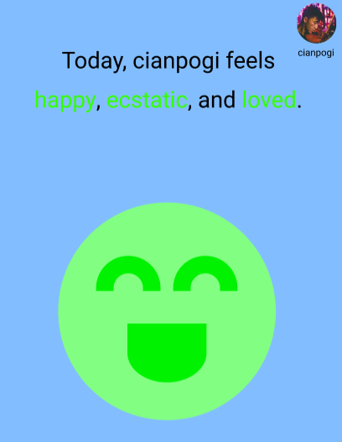
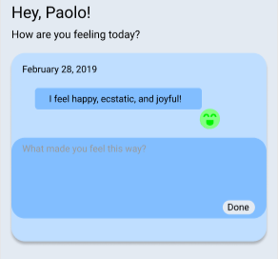
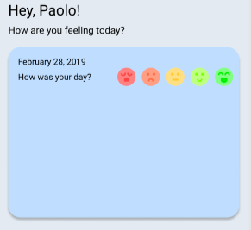
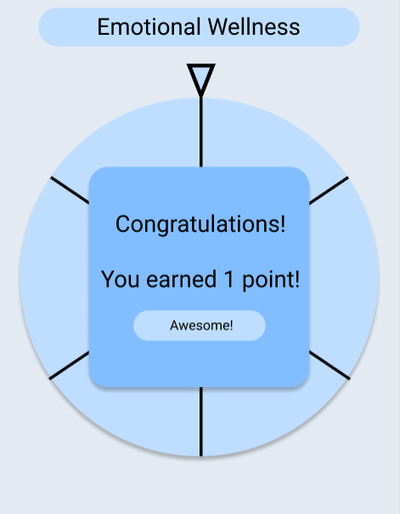
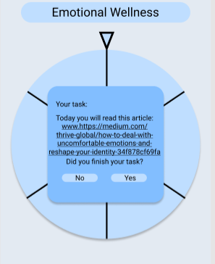
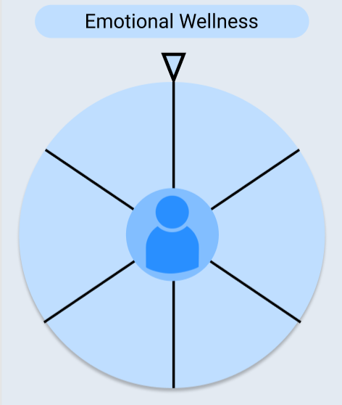
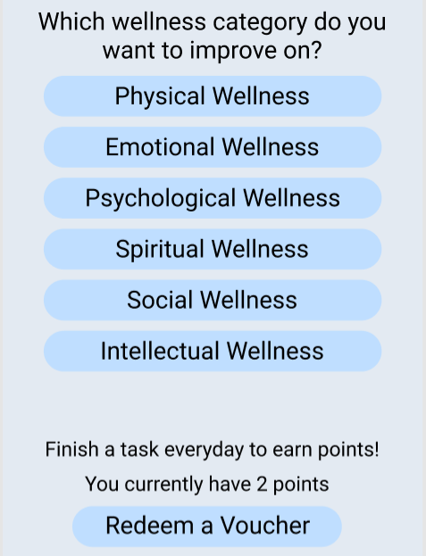

features
mini-task completion incentives
today’s feel ™
daily journals
emotions in pixels
yearly
monthly
weekly

Slide 5
Framework
Mobile Apps
React Native
EXPO
Backend
Express.JS
Node.JS
Mongoose

Slide 6
app demo

